Slide 1
Natural Language Processing
Noble Xavier

Slide 2
NLP INTRODUCTION

Slide 3
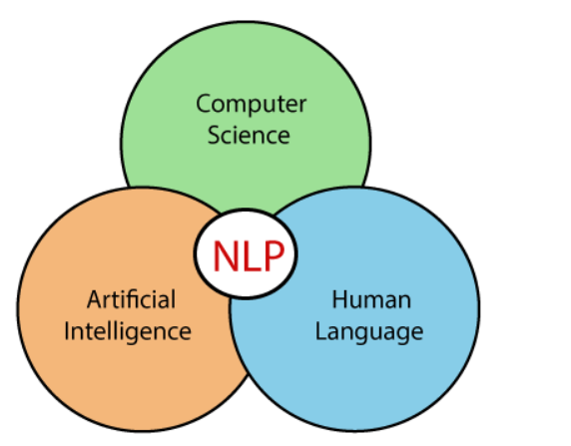
NLP Definition
Natural language processing (NLP) is a part of computer science and artificial intelligence which deals with human languages
Natural language processing (NLP) is a machine-learning technology that allows computers to understand, manipulate, and interpret human language.
Organizations use NLP software to process large amounts of voice and text data from various sources, such as emails, social media, and video, and respond in real-time to human communication

Slide 4
Applications of NLP
Sentiment analysis
Analyzes digital text to determine if the message's emotional tone is positive, negative, or neutral
Machine translation
Uses artificial intelligence to automatically translate text from one language to another without human involvement
Chatbots
Allows chatbots to communicate with other chatbots or humans through auditory or textual methods
AI software
Used in question-answering software for knowledge representation, analytical reasoning, and information retrieval

Slide 5
Applications of NLP
Speech recognition
Also known as speech-to-text, this is the process of converting voice data into text data
Natural language generation (NLG)
The opposite of speech recognition, NLG puts structured information into conversational human language
Natural language understanding (NLU)
A subset of NLP that focuses on analyzing the meaning behind sentences
Named entity recognition (NER)
Tags and extracts "named identities" within the text for further analysis
Summarization
Can be extractive, which focuses on extracting the most important sentences from a long text and combining them to form a summary, or abstractive, which produces a summary by paraphrasing

Slide 6
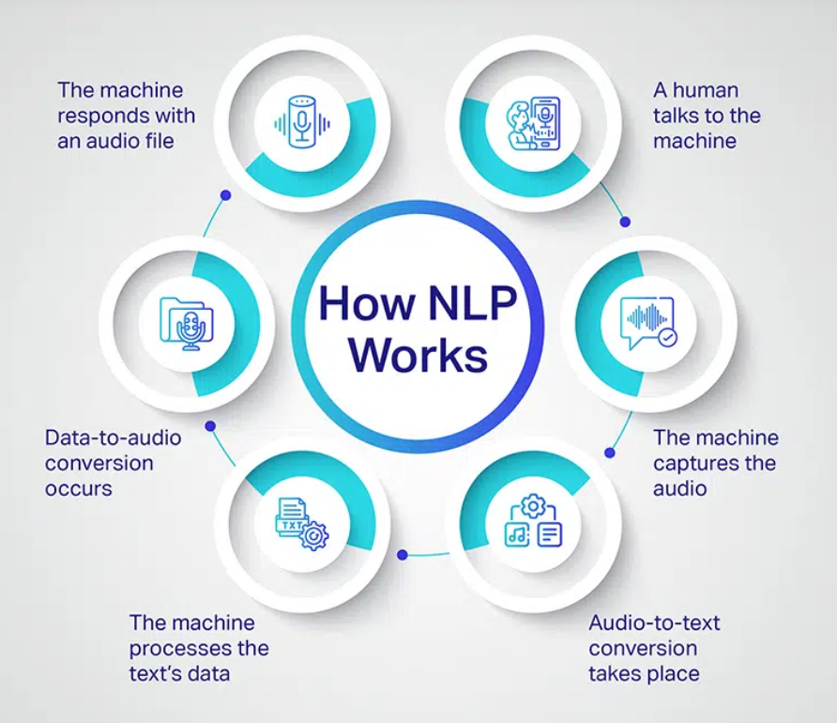
Working of NLP

Slide 7
Components of NLP
There are the following two components of NLP
Natural Language Understanding (NLU)
Natural Language Understanding (NLU) helps the machine understand and analyze human language by extracting metadata from content such as concepts, entities, keywords, emotions, relations, and semantic roles.
NLU involves the following tasks -
It is used to map the given input into useful representation.
It is used to analyze different aspects of the language.
2. Natural Language Generation (NLG)
Natural Language Generation (NLG) acts as a translator that converts the computerized data into natural language representation. It mainly involves Text planning, Sentence planning, and Text Realization.

Slide 8
Components of NLP
Natural Language Understanding (NLU) | Natural Language Generation (NLG)
NLU is the process of reading and interpreting language. | NLG is the process of writing or generating language.
It produces non-linguistic outputs from natural language inputs. | It produces constructing natural language outputs from non-linguistic inputs.

Slide 9
NLP-Ambiguity
Natural language ambiguity refers to situations where a word, phrase, or sentence has multiple meanings, making it challenging to interpret correctly.
Part Of Speech (POS) Tagging Ambiguity
POS tagging refers to the process of classifying words in a text to a part of speech - whether the word is a verb, noun, etc.
Example
I need to mail my friend the files. (Verb)
I need to find the mail that was sent to me. (Noun)

Slide 10
NLP-Ambiguity
Structural Ambiguity
This ambiguity arises because the same exact sentence can be interpreted differently based on how the sentence is parsed.
Example
I saw someone with a telescope
This sentence can be interpreted to mean that the speaker was using a telescope, or that they saw someone with a telescope
The child looked at the lady using the magnifying glass
This sentence can be interpreted to mean that either the child or the lady was using the magnifying glass.

Slide 11
NLP-Ambiguity
Scope Ambiguity
Scope ambiguity can occur in sentences when the meaning of different parts of an expression is interpreted in different places.
Example
All students learn a programming language.
The first is that all students learn the same programming language.
They all learn a language that doesn’t have to be the same one.

Slide 12
NLP-Ambiguity
Lexical Ambiguity
Certain words have the property that they can have multiple different meanings.
There are two forms of lexical ambiguity that exist Polysemy and Homonymy.
Polysemy − This is when two words are the same but have a different meaning depending on the usage, i.e the word Foot. Foot can describe the body part or the foot of the building. Essentially, you are describing the base of something with the word foot.
Homonym − This occurs when a word has the same spelling or pronunciation, but has different meanings overall.
The word bass for example can be referring to the musical instrument, or a type of fish.
The words horse and hoarse. These two have similar pronunciations, but horse refers to the animal and hoarse refers to a sore throat.

Slide 13
NLP-Ambiguity
Lexical Ambiguity Examples
She is looking for a match
Match has a different meaning
The Fisherman went to the bank
Bank has different meaning River Bank or Financial institution

Slide 14
NLP-Ambiguity
Semantic Ambiguity
The same sentences can have multiple meanings depending on the context.
Example
He ate the burnt lasagna and pie could mean one of two things
That the lasagna was burnt and the pie wasn’t.
That both were burnt.
One morning, I shot an elephant in my pyjamas
Was the elephant in pyjamas or man was in pajamas

Slide 15
NLP-Ambiguity
Referential Ambiguity
Referential ambiguity occurs when a phrase can have multiple interpretations due to the use of multiple objects and the referencing not being clear.
Example
I looked at Michelle with the telescope.
Michelle herself was carrying the telescope.
The person saying the sentence was using a telescope to see Michelle.
The boy told his father the theft. He was very upset.
Here who does "He" refer to

Slide 16
NLP-Ambiguity
Anaphoric Ambiguity
The use of pronouns can cause some confusion if there are multiple people being mentioned in a sentence.
Example
Michelle told Romany that she ate the cake.
From the sentence alone it is not exactly clear whether ‘she’ is referring to Michelle or Romany.
Margaret invited Susan for a visit, but she told her she had to go to work.
Here "she" and "her" can be used for for Susan and Margaret interchangeably, which give two different meanings.

Slide 17
NLP-Ambiguity
Pragmatic Ambiguity
when the statement is not specific, and the context does not provide the information needed to clarify the statement. (Some Information is Missing)
Example
Ice cream is good this time of year
This statement implies that the speaker wants to eat ice cream, even though they didn't explicitly say so.
He is an Italian
This phrase can imply that the speaker is expressing contempt.

Slide 18
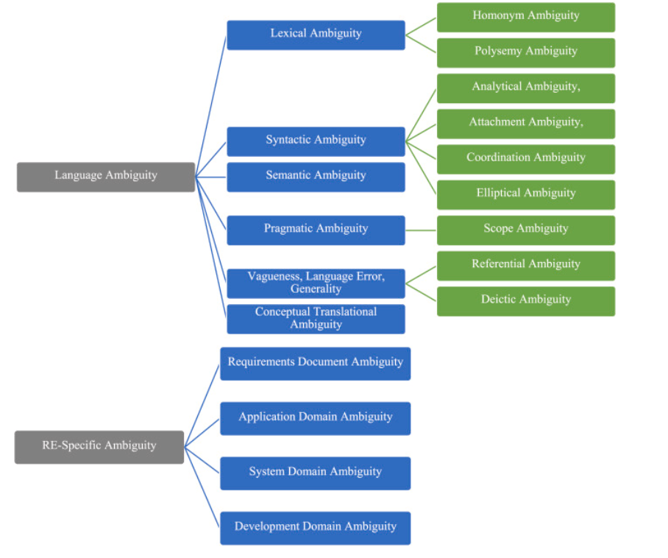
NLP-Ambiguity

Slide 19
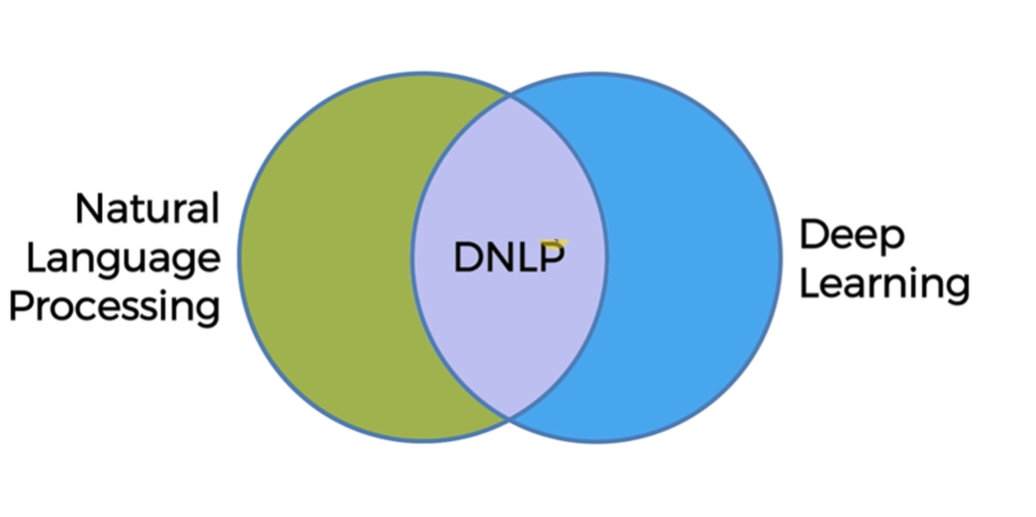
Types of NLP

Slide 20
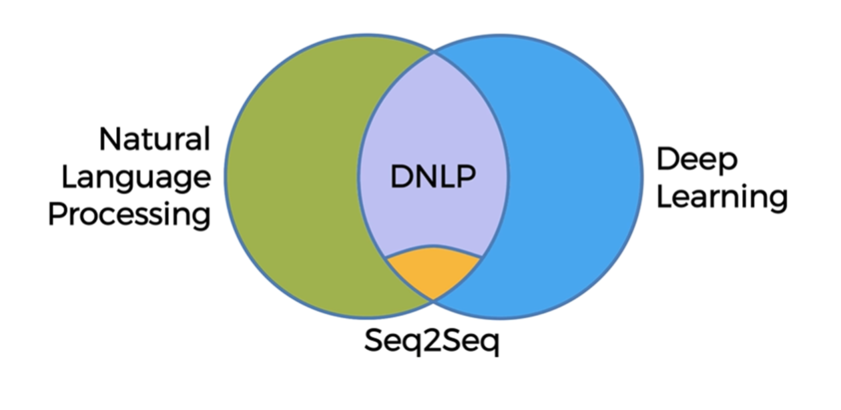
Types of NLP
Seq2Seq – Sequence to Sequence

Slide 21
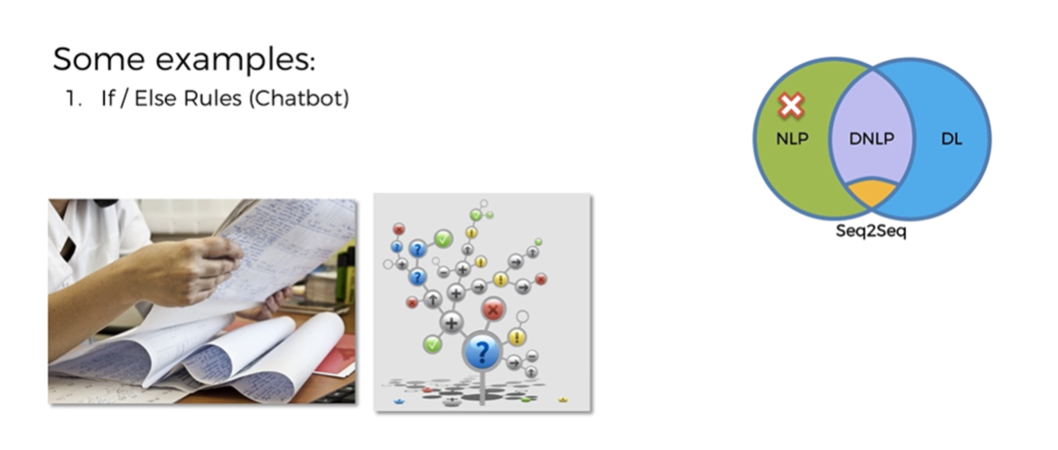
Examples NLP- Chatbot

Slide 22
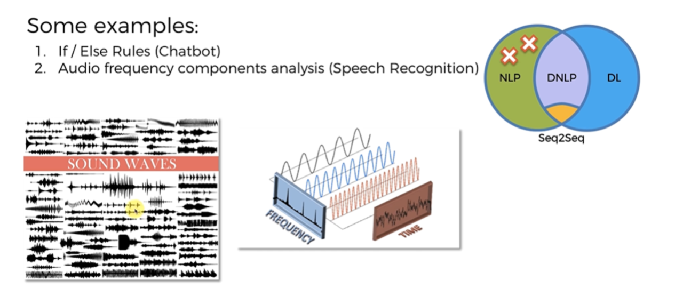
Examples NLP- Voice Recognition

Slide 23
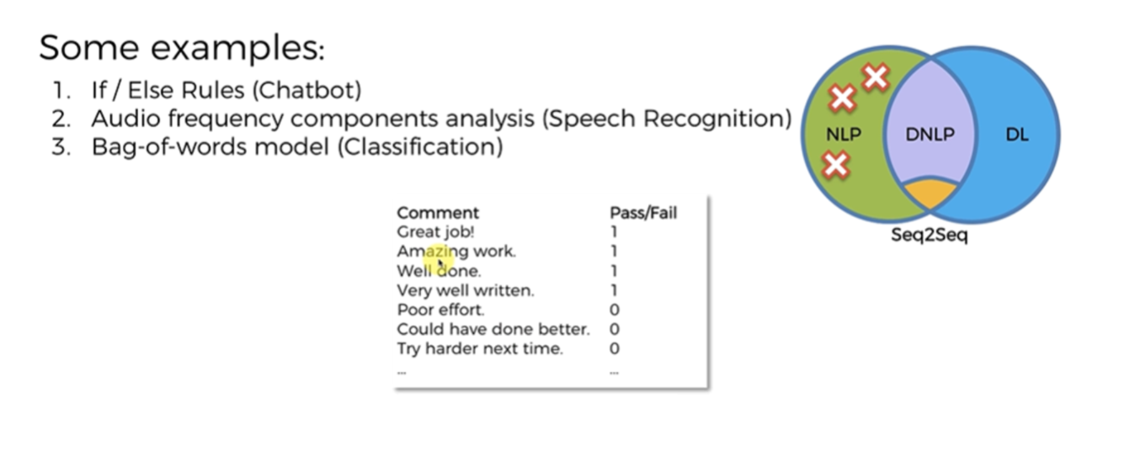
Examples NLP- Bag of Words

Slide 24
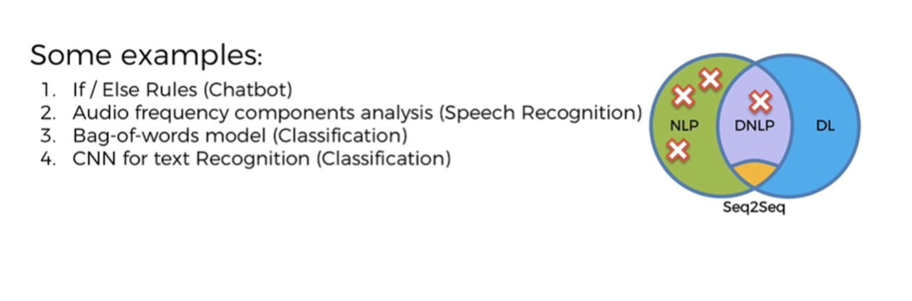
Examples NLP- CNN Text Recognition

Slide 25
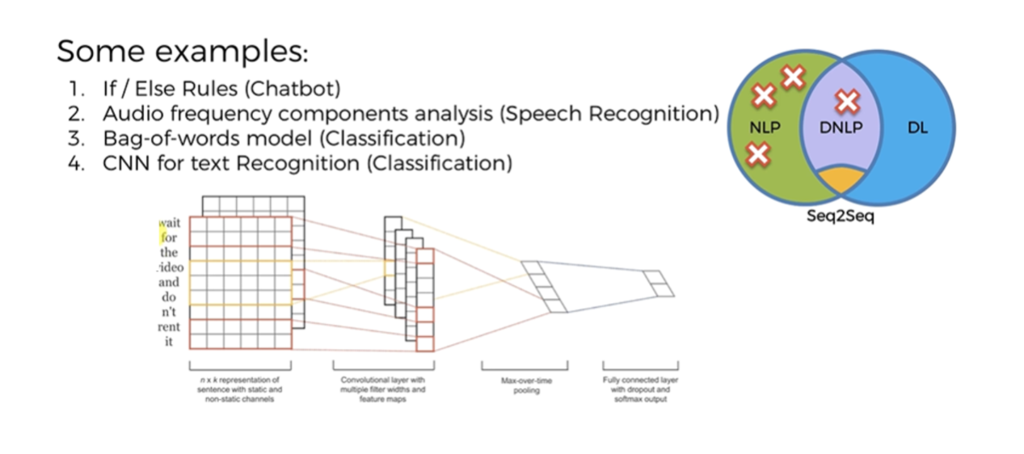
Examples NLP- CNN Text Recognition

Slide 26
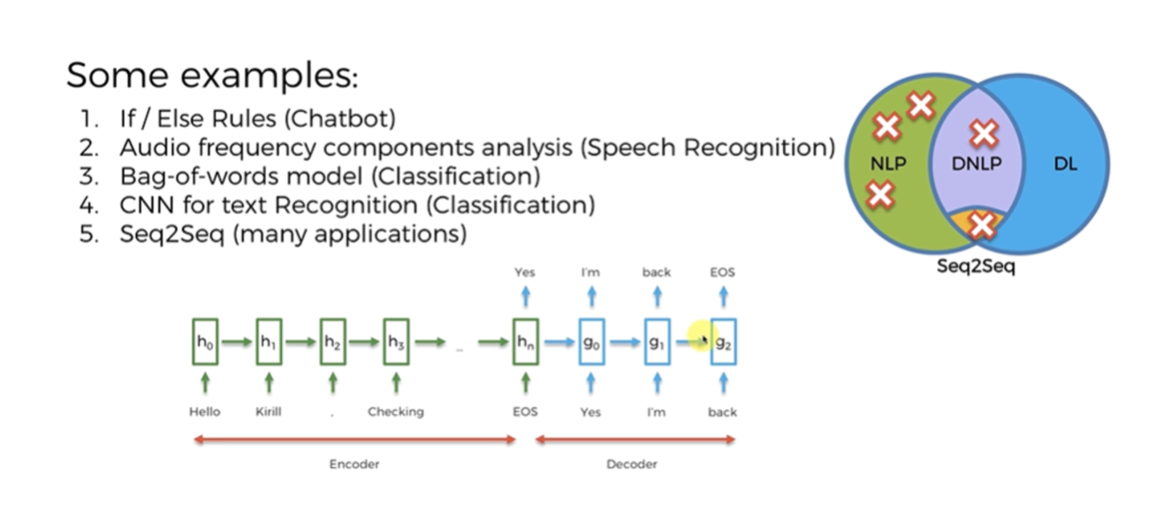
Examples NLP- Seq2Seq

Slide 27
BAG OF WORDS

Slide 28
Bag of Words
Bag of words (BoW) is a natural language processing (NLP) model that extracts features from text to help machine learning algorithms process it.
The model treats a document as a "bag" of words, rather than a sequence, and represents it by counting the frequency of each word. The order of words and their context are ignored
Document | the | cat | sat | in | hat | with
the cat sat | 1 | 1 | 1 | 0 | 0 | 0
the cat sat in the hat | 2 | 1 | 1 | 1 | 1 | 0
the cat with the hat | 2 | 1 | 0 | 0 | 1 | 1

Slide 29
Steps to create Bag of Words
Step 1: Collect Data
Step 2: Design the Vocabulary
Now we can make a list of all unique words in our model vocabulary.
Step 3: Create Document Vectors
The objective is to turn each document of free text into a vector that we can use as input or output for a machine-learning model.

Slide 30
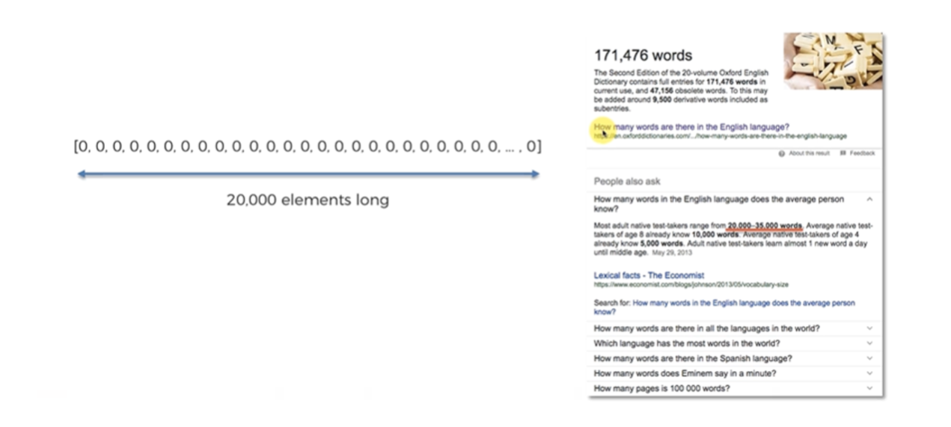
Bag of Words
Create a Vector with size 20000, In English, assume there are 20000 words commonly used

Slide 31
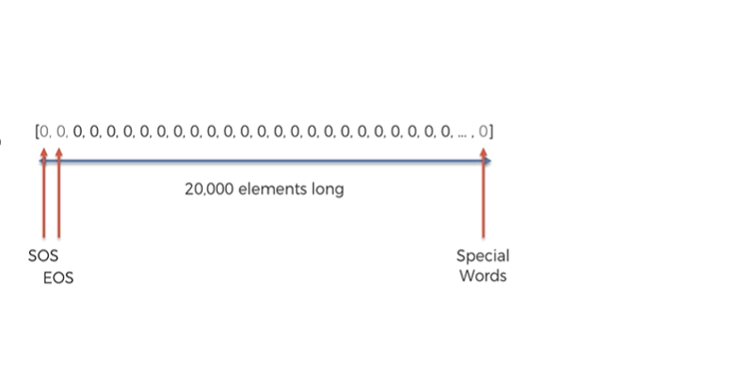
Bag of Words
1st Position is for start of sentences.
2Nd Position is for end of sentences.
Last positions for Special words.

Slide 32
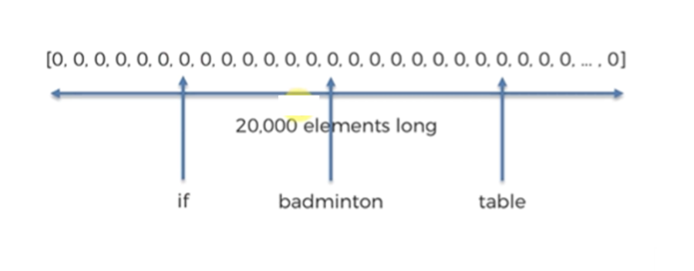
Bag of Words
Each of the 20000 words will be assigned to a fixed position

Slide 33
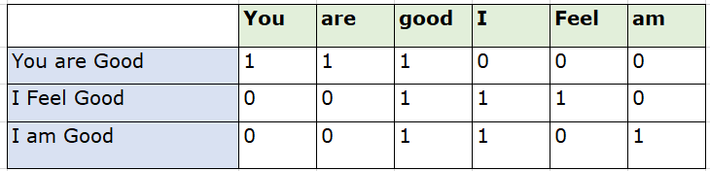
Bag of Words-Example

Slide 34
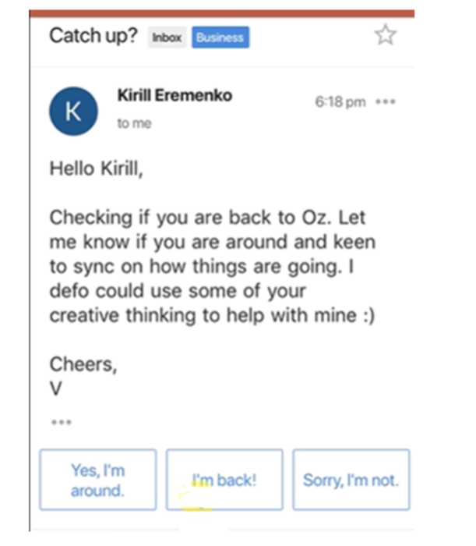
Bag of Words
Sample Email

Slide 35
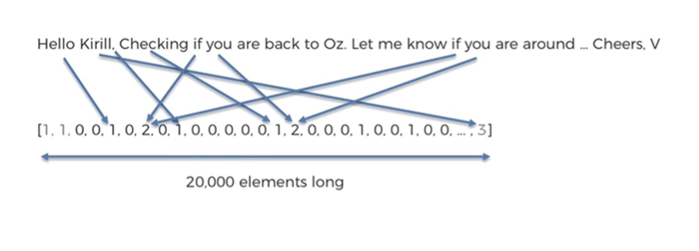
Bag of Words
Fill the sentence in the vector. The number in the vector represents how many times each word repeated .
Eg , Corresponds to the word “if” , number is 2 , means the word “if” occurred two times ,
Last number 3 means , there are three special words in the sentence , they are Kirill, Oz, V

Slide 36
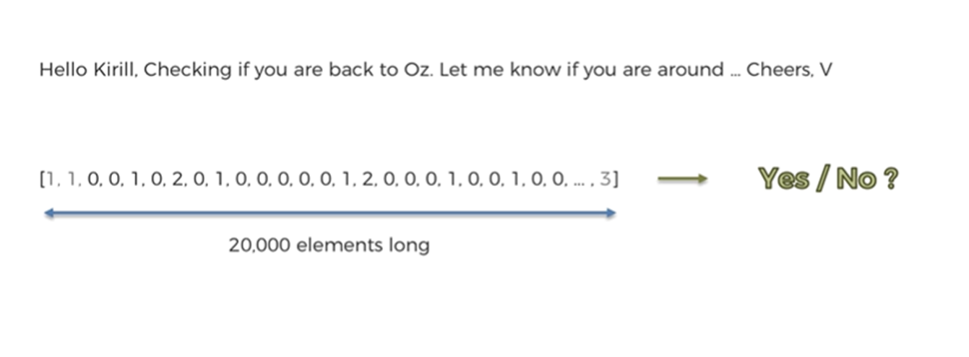
Bag of Words

Slide 37
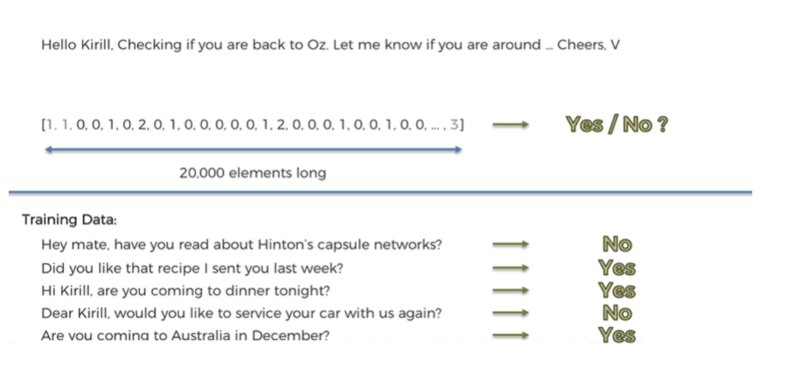
Bag of Words

Slide 38
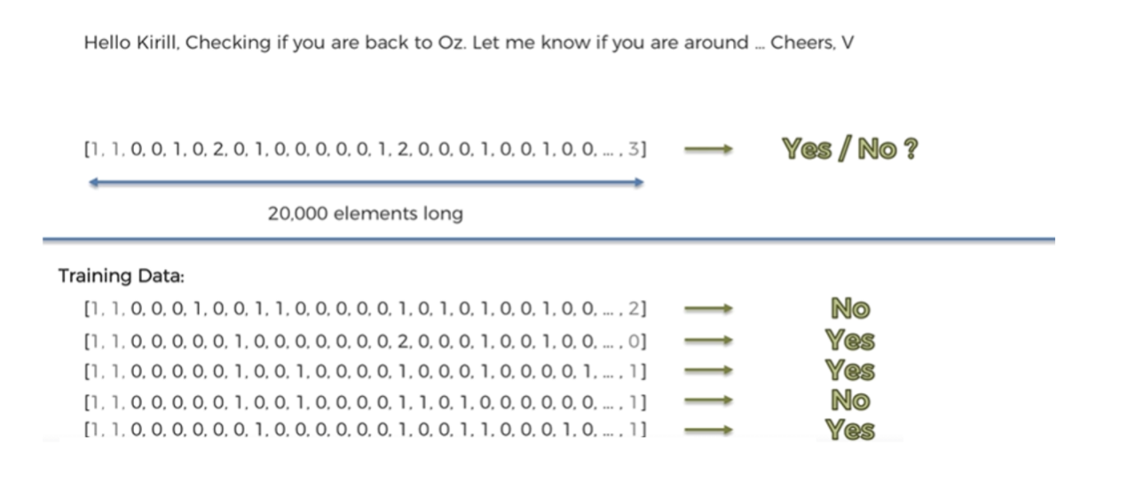
Bag of Words

Slide 39
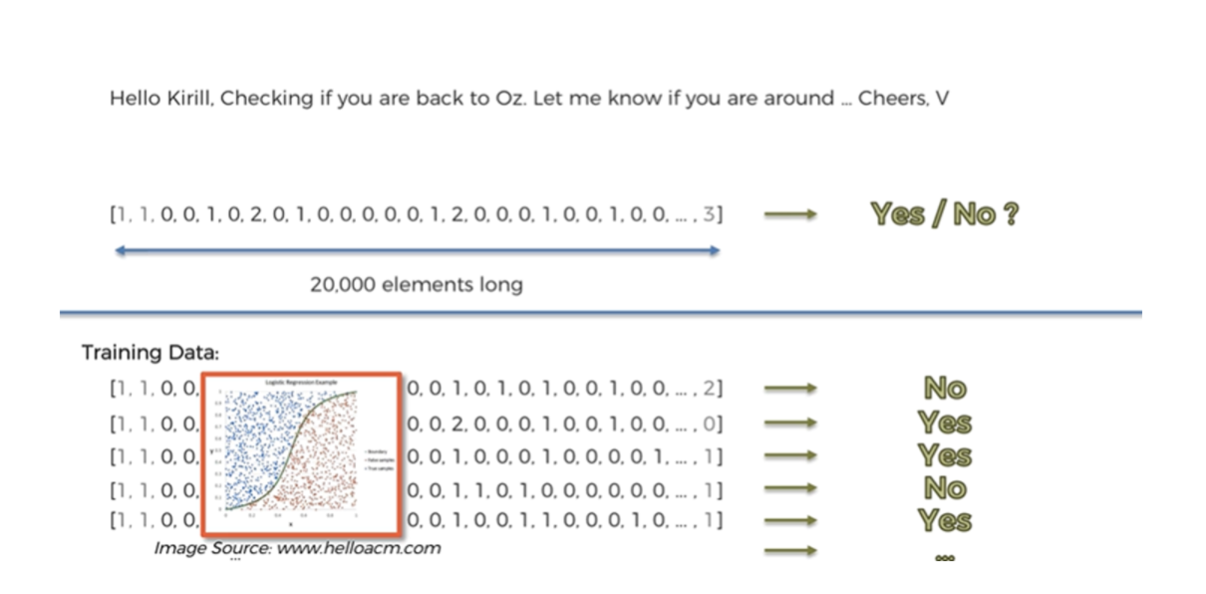
Bag of Words
Apply the Logistical Regression Model

Slide 40
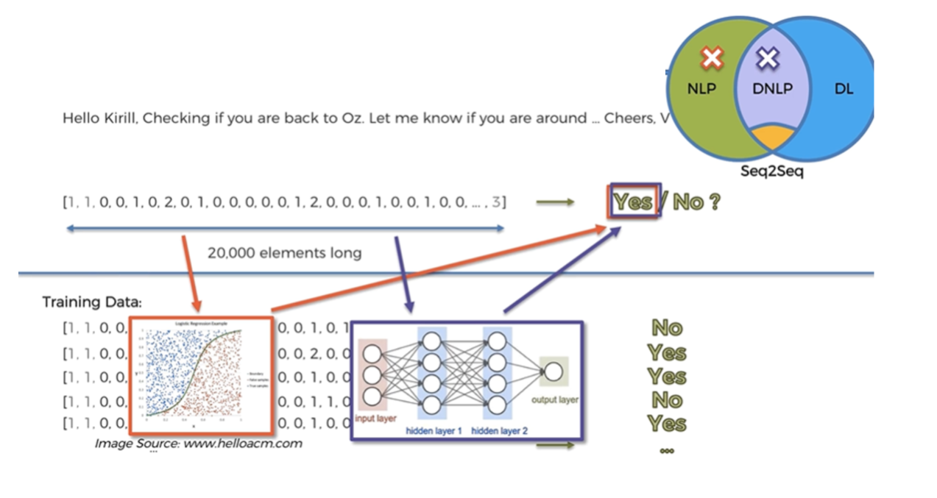
Bag of Words

Slide 41
NLTK

Slide 42
Natural Language Toolkit (NLTK)
NLTK is Pythons API library for performing an array of tasks in human language.
It can perform a variety of operations on textual data, such as classification, tokenization, stemming, tagging, Leparsing, semantic reasoning, etc.
NLTK is used to process and analyze textual data for natural language processing (NLP) tasks in artificial intelligence. It's a popular tool for computational linguistics and NLP and can be used for a variety of tasks
Installation:
NLTK can be installed simply using pip or by running the following code.
! pip install nltk

Slide 43
NLTK Modules
A summary of popular NLTK modules is given in the table below.
S.No | Language Processing Task | NLTK module
1 | Accessing Corpora | nltk.corpus
2 | String Processing | nltk.tokenize, nltk.stem
3 | Collocation discovery | nltk.collocations
4 | Part-of-speech tagging | nltk.tag
5 | Classification | nltk.classify, nltk.cluster
6 | Chunking | nltk.chunk
7 | Parsing | nltk.parse
8 | Semantic interpretation | nltk.sem, nltk.inference
9 | Evaluation metrics | nltk.metrics
10 | Probability and Estimation | nltk.probability
11 | Applications | nltk.app, nltk.chat
12 | Linguistic fieldwork | nltk.toolbox

Slide 44
NLP – Data Preprocessing (Tokenization)
1. Tokenization
Tokenization is the process of breaking down a string of text into smaller units, called tokens. These tokens can be words, phrases, or even individual characters, depending on your requirements
Here are a few ways to perform tokenization in Python
Using the split() method:
This is the simplest way to tokenize text, where the string is split based on a specified delimiter (usually whitespace).

Slide 45
NLP – Data Preprocessing (Tokenization)
Using Regular Expressions (RegEx):
RegEx provides more flexibility in defining tokenization rules. You can use the re module to create custom patterns for splitting text.
Using the Natural Language Toolkit (NLTK):
NLTK is a powerful library for NLP tasks, including tokenization. It offers different tokenizers
Using SpaCy:
SpaCy is another popular NLP library known for its efficiency and accuracy. It provides a tokenizer that is optimized for speed and handles a variety of features.

Slide 46
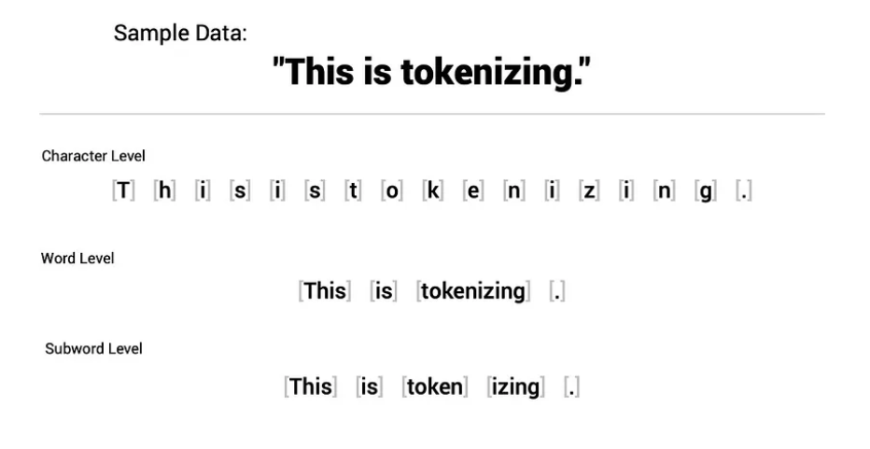
NLP – Types of Tokenization
Types of tokenization in nlp
Word Tokenization: Common for languages with clear separation (e.g., English).
Character Tokenization: Useful for languages without clear separation or for very detailed analysis.
Subwords Tokenization: Smaller than words, but bigger than characters (useful for complex languages or unknown words).

Slide 47
NLP – Data Preprocessing (Punctuation)
2. Punctuation Removal
In Natural Language Processing (NLP), removing punctuation marks is a critical preprocessing step that can significantly impact the outcome of various tasks and analyses.
Punctuation marks can divide text into sentences, paragraphs, and phrases, and they can affect the results of any text processing approach. For example, in models such as sentiment analysis and spam detection, punctuation marks are generally removed, but they can be used in text generation models.
ways to remove punctuation in NLP
Natural Language Toolkit (NLTK): Use the RegexpTokenizer to tokenize a string, excluding matches based on the provided regular expression.
Spacy: Create a spacy document consisting of tokens, extract only those tokens that are not punctuation, and then join those tokens back up into the text.

Slide 48
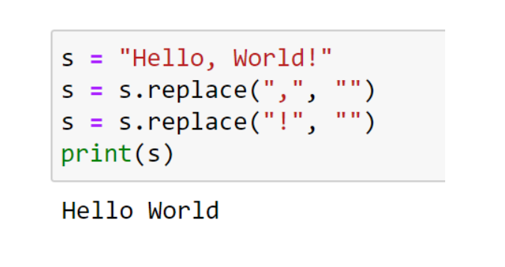
NLP – Data Preprocessing (Punctuation)
Example
When removing punctuation, it's important to take care of the text.
For example, "don't" may convert to "dont" or "don t" depending on what you set in the parameter.

Slide 49
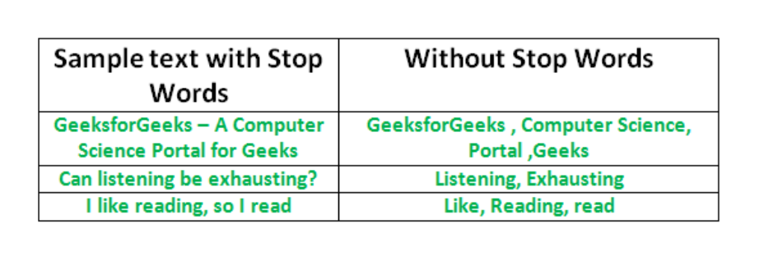
NLP – Data Preprocessing (Stop Words)
3. Stop Words Removal
Stop words are words that are filtered out before or after processing natural language data because they are considered insignificant.
Stop words are usually common words that don't carry much meaning and occur frequently in a language, such as "the," "and," and "is" in English. They are typically articles, prepositions, conjunctions, or pronouns used for grammatical purposes.

Slide 50
NLP – Data Preprocessing (Stop Words)
Example
In English, some examples of stop words include:
Articles: a, an, the
Conjunctions: and, but, or
Prepositions: in, on, at, with
Pronouns: he, she, it, they
Common verbs: is, am, are, was, were, be, being, been

Slide 51
NLP – Data Preprocessing (Stemming)
4. Stemming
Stemming is a text preprocessing technique in natural language processing (NLP) that reduces a word's inflected form to its root form, or "lemma“
It can also help with: Understanding differences between words, Simplifying words, Improving search accuracy, Reducing dimensionality, and Speeding up processing time.
Some more examples stemming from the root word "like" include:
"likes"
"liked"
"likely"
"liking“

Slide 52
NLP – Data Preprocessing (Stemming)
Types of Stemmer in NLTK
There are several kinds of stemming algorithms, and all of them are included in Python NLTK
1. Porter Stemmer – PorterStemmer()
PorterStemmer() is a module in NLTK that implements the Porter Stemming technique.
Five steps of word reduction are used in the method, each with its own set of mapping rules.
Porter Stemmer is the original stemmer and is renowned for its ease of use and rapidity. Frequently, the resultant stem is a shorter word with the same root meaning.

Slide 53
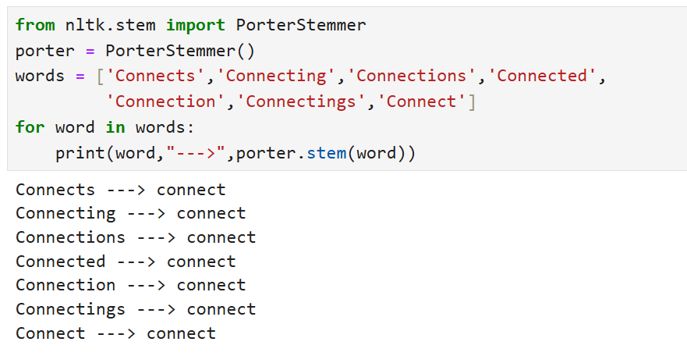
NLP – Data Preprocessing (Stemming)
Example
from nltk.stem import PorterStemmer
porter = PorterStemmer()
words = ['Connects','Connecting','Connections','Connected',
'Connection','Connectings','Connect']
for word in words:
print(word,"--->",porter.stem(word))

Slide 54
NLP – Data Preprocessing (Stemming)
2. Snowball Stemmer – SnowballStemmer()
The method utilized in this instance is more precise and is referred to as “English Stemmer” or “Porter2 Stemmer.”
It is somewhat faster and more logical than the original Porter Stemmer.
Example
from nltk.stem import SnowballStemmer
snowball = SnowballStemmer(language='english')
words = ['generous','generate','generously','generation']
for word in words:
print(word,"--->",snowball.stem(word))

Slide 55
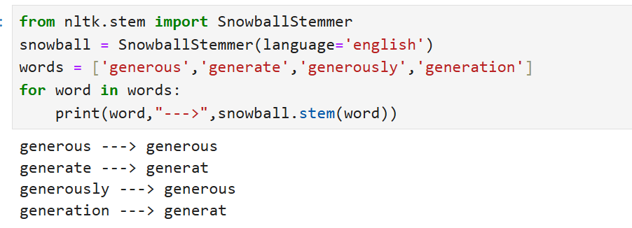
NLP – Data Preprocessing (Stemming)
Result

Slide 56
NLP – Data Preprocessing (Stemming)
3. Lancaster Stemmer – LancasterStemmer()
Lancaster Stemmer is straightforward, although it often produces results with excessive stemming. Over-stemming renders stems non-linguistic or meaningless.
Example
from nltk.stem import LancasterStemmer
lancaster = LancasterStemmer()
words = ['eating','eats','eaten','puts','putting']
for word in words:
print(word,"--->",lancaster.stem(word))

Slide 57
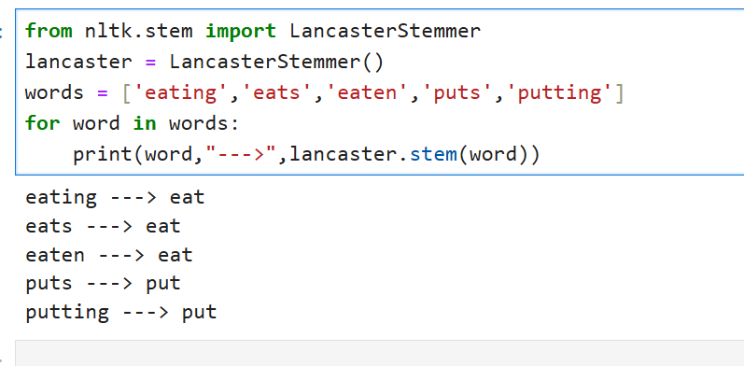
NLP – Data Preprocessing (Stemming)
Result

Slide 58
NLP – Data Preprocessing (Stemming)
4. Regexp Stemmer – RegexpStemmer()
Regex stemmer identifies morphological affixes using regular expressions. Substrings matching the regular expressions will be discarded.
Example
from nltk.stem import RegexpStemmer
regexp = RegexpStemmer('ing$|s$|e$|able$', min=4)
words = ['mass','was','bee','computer','advisable']
for word in words:
print(word,"--->",regexp.stem(word))

Slide 59
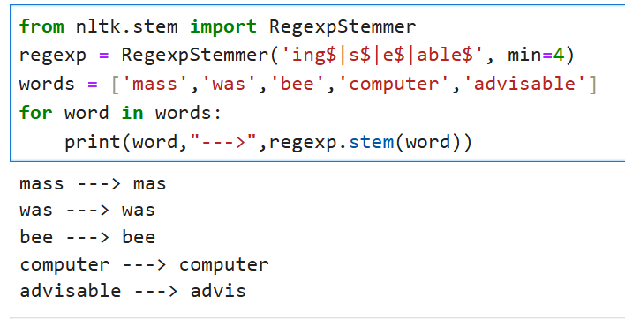
NLP – Data Preprocessing (Stemming)
Result

Slide 60
NLP – Data Preprocessing (Stemming)
Porter vs Snowball vs Lancaster vs Regex Stemming in NLTK
Word | Роrter Stemmer | Snowball Stemmer | Lancaster Stemmer | Regexp Stemmer
friend | friend | friend | friend | friend
friendship | friendship | friendship | friend | friendship
friends | friend | friend | friend | friend
friendships | friendship | friendship | friend | friendship

Slide 61
NLP – Data Preprocessing (Lemmatization)
5. Lemmatization
Lemmatization is a natural language processing (NLP) technique that reduces words to their base or dictionary form, called a lemma. It involves grouping inflected forms of a word so they can be analyzed as a single item.
For example, the words "running," "ran," and "runs" are all lemmatized to the lemma "run“
Examples of lemmatization:
-> rocks : rock
-> corpora : corpus
-> better : good

Slide 62
NLP – Data Preprocessing (Lemmatization)
Lemmatization Techniques
1. Rule Based Lemmatization
Rule-based lemmatization involves the application of predefined rules to derive a word’s base or root form.
Examples of rule-based lemmatization for English verbs:
Rule: For regular verbs ending in “-ed,” remove the “-ed” suffix.
Example:
Word: “walked”
Rule Application: Remove “-ed”
Result: “walk”

Slide 63
NLP – Data Preprocessing (Lemmatization)
Lemmatization Techniques
2. Dictionary-Based Lemmatization
Dictionary-based lemmatization relies on predefined dictionaries or lookup tables to map words to their corresponding base forms or lemmas. Each word is matched against the dictionary entries to find its lemma.
Suppose we have a dictionary with lemmatized forms for some words:
‘running’ -> ‘run’
‘better’ -> ‘good’
‘went’ -> ‘go’
When applying dictionary-based lemmatization to a text like “I was running to become a better athlete, and then I went home,” the resulting lemmatized form would be:
“I was run to become a good athlete, and then I go home.”

Slide 64
NLP – Data Preprocessing (Lemmatization)
Lemmatization Techniques
3. Machine Learning-Based Lemmatization
Machine learning-based lemmatization leverages computational models to automatically learn the relationships between words and their base forms.
Example:
Consider a machine learning-based lemmatizer trained on diverse texts. When encountering the word ‘went,’ the model, having learned patterns, predicts the base form as ‘go.’ Similarly, for ‘happier,’ the model deduces ‘happy’ as the lemma.

Slide 65
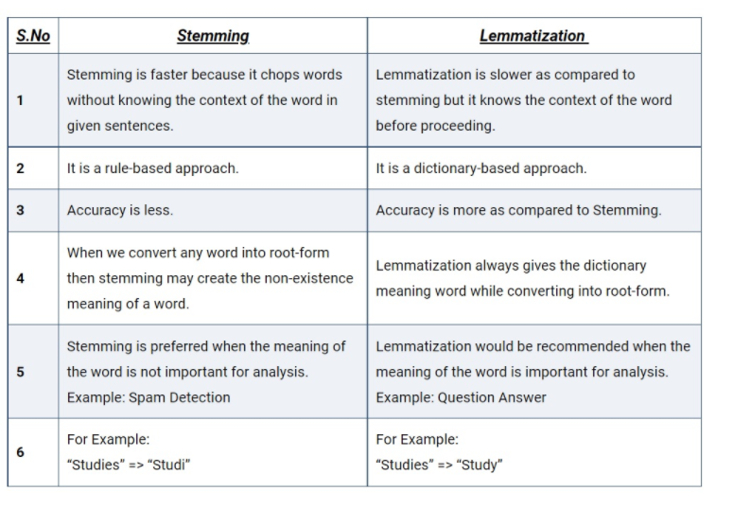

Slide 66
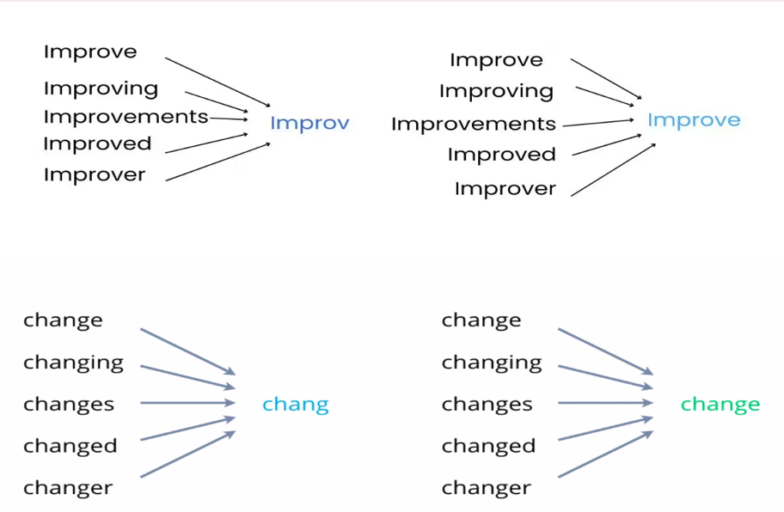
Examples of Stemming vs lemmatization

Slide 67
NLP – Data Preprocessing (POS Tagging)
6. POS Tagging
Parts of Speech tagging is a linguistic activity in Natural Language Processing (NLP) wherein each word in a document is given a particular part of speech (adverb, adjective, verb, etc.) or grammatical category.
The goal is to understand the syntactic structure of a sentence and identify the grammatical roles of individual words.

Slide 68
NLP – Data Preprocessing (POS Tagging)
POS tags are short codes representing specific parts of speech.
Common POS tags are
Noun (NN)
Verb (VB)
Adjective (JJ)
Adverb (RB)
Pronoun (PRP)
Preposition (IN)
Conjunction (CC)
Determiner (DT)
Interjection (UH)

Slide 69
NLP – Data Preprocessing (POS Tagging)
Example of POS Tagging
Consider the sentence: “The quick brown fox jumps over the lazy dog.”
After performing POS Tagging:
“The” is tagged as a determiner (DT)
“quick” is tagged as an adjective (JJ)
“brown” is tagged as an adjective (JJ)
“fox” is tagged as a noun (NN)
“jumps” is tagged as a verb (VBZ)
“over” is tagged as a preposition (IN)
“the” is tagged as determiner (DT)
“lazy” is tagged as an adjective (JJ)
“dog” is tagged as noun (NN)

Slide 70
NLP – Data Preprocessing (POS Tagging)
Methods of POS Tagging:
Rule-Based Tagging:
Based on handcrafted rules considering word morphology, context, and syntactic information. It can be effective but may struggle with ambiguity.
Example
Rule: Assign the POS tag “noun” to words ending in “-tion” or “-ment.”
Text: “The presentation highlighted the key achievements of the project’s development.”

Slide 71
NLP – Data Preprocessing (POS Tagging)
Methods of POS Tagging:
Text: “The presentation highlighted the key achievements of the project’s development.”
Rule-based Tags:
“The” – Determiner (DET)
“presentation” – Noun (N)
“highlighted” – Verb (V)
“the” – Determiner (DET)
“key” – Adjective (ADJ)
“achievements” – Noun (N)
“of” – Preposition (PREP)
“the” – Determiner (DET)
“project’s” – Noun (N)
“development” – Noun (N)

Slide 72
NLP – Data Preprocessing (POS Tagging)
Methods of POS Tagging:
2. Transformation Based tagging
Transformation-based tagging (TBT) is a part-of-speech (POS) tagging method that uses a set of rules to change the tags that are applied to words inside a text.
In contrast, statistical POS tagging uses trained algorithms to predict tags probabilistically, while rule-based POS tagging assigns tags directly based on predefined rules.

Slide 73
NLP – Data Preprocessing (POS Tagging)
Methods of POS Tagging:
Example Transformation-based tagging
Consider the transformation rule: Change the tag of a verb to a noun if it follows a determiner like “the.”
Text: “The cat chased the mouse”.
Initial Tags:
“The” – Determiner (DET)
“cat” – Noun (N)
“chased” – Verb (V)
“the” – Determiner (DET)
“mouse” – Noun (N)
Methods of POS Tagging:
Example Transformation-based tagging
Transformation rule applied:
Change the tag of “chased” from Verb (V) to Noun (N) because it follows the determiner “the.”
Updated tags:
“The” – Determiner (DET)
“cat” – Noun (N)
“chased” – Noun (N)
“the” – Determiner (DET)
“mouse” – Noun (N)

Slide 74
NLP – Data Preprocessing (POS Tagging)
Methods of POS Tagging:
3. Statistical Tagging:
Uses statistical models trained on large annotated corpora to predict POS tags. Hidden Markov Models (HMMs) and Conditional Random Fields (CRFs) are common statistical approaches.
4. Machine Learning-Based Tagging:
Utilizes machine learning algorithms such as decision trees, support vector machines, or neural networks to learn patterns from data. Particular emphasis is given to contextual information.
5. Deep Learning-Based Tagging:
Deep learning models, such as recurrent neural networks (RNNs) and long short-term memory networks (LSTMs), are employed for POS tagging, capturing complex contextual dependencies.

Slide 75
NLP – Data Preprocessing (Chunking)
7. Chunking
Chunking is a process of extracting phrases from unstructured text, which means analyzing a sentence to identify the constituents(Noun Groups, Verbs, verb groups, etc.)
However, it does not specify their internal structure, nor their role in the main sentence.

Slide 76
NLP – Data Preprocessing (Chunking)
A sentence typically follows a hierarchical structure consisting of the following components.
sentence → clauses → phrases → words
Group of words make up phrases and there are five major categories.
Noun Phrase (NP)
Verb phrase (VP)
Adjective phrase (ADJP)
Adverb phrase (ADVP)
Prepositional phrase (PP)
Phrase structure rules:
S -> NP VP
NP -> {Det N,Pro,PN}
VP -> V (NP) (PP) (Adv)
PP -> P NP
AP -> A (PP)

Slide 77
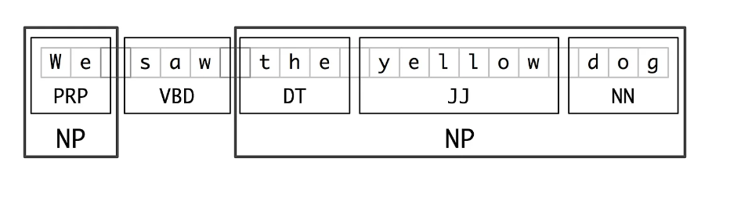
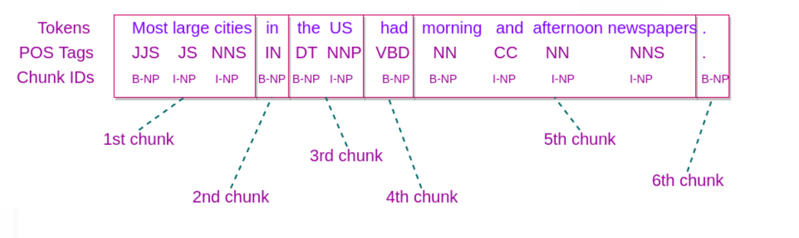
NLP – Data Preprocessing (Chunking)

